Slide 1

North Western University, Khulna
A Secure and Privacy Preserving Medical Image Sharing Scheme for E-Healthcare using Blockchain
Presented By
B2
Hirak Mondal ID: 20201046010 | Sajib Datta ID: 20201037010 | Sajib Bhattacharjee ID: 20201070010 | Broti Mondal ID:20201170010 | Saiket Kumar Ray ID: 20201056010

Slide 2
Outlines
1
Introduction
Motivation
Objectives
Related Works
Methodology
Outcomes and Impacts
Comparative analysis
Conclusion
Future Work
References

Slide 3
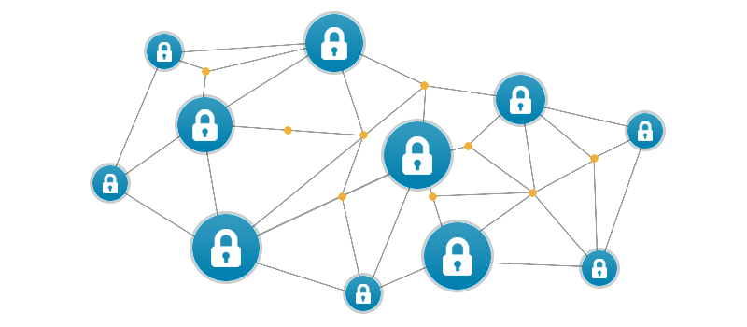
2
Introduction
The healthcare industry has undergone a dynamic resolution.
Medical images such as X-rays and MRIs are now stored and transmitted electronically.
This shift offers benefits like efficient storage and sharing.
However, it also raises concerns about security and privacy.

Slide 4
3
Motivation
E-healthcare's digital images raise security concerns.
Blockchain offers a secure way to store and transmit them.
Watermarking strengthens security and privacy further.

Slide 5
4
Objectives
Our main objective is to Medical Image Sharing Scheme for E-Healthcare using Blockchain.
That can data secure using blockchain

Slide 6
5
Related Works
Jaishree Jain and Arpit Jain et al proposed a method of Securing E-Healthcare Images Using an Efficient Image Encryption Model [1]:
SDIM-based cryptosystem diaperse medieval images weer BGD channels, enhancing e-healthcare veracity.
Outperforms existing methods, safeguarding patient data with MHAM encryption and validation, ensuring efficacy in securing medical images.

Slide 7
6
Related Works (Continue)
Mohammad kamrul hasan and Shayla Islam proposed Lightweight Encryption Technique to Enhance Medical Image Security on Internet of Medical Things Applications [2]:
Regular encryption is inefficient for large medical images due to their redundancy.
The research proposes a lightweight permutation-based method for securing medical images in IoMT.

Slide 8
7
Related Works…Cont
Priyanka and Sushila Maheshkar et al. used a method of An Efficient DCT based Image Watermarking Using RGB Color Space [3]:
This research proposes a DCT-based watermarking system for color images. This method improves security and maintains image quality.
The method achieves good imperceptibility and robustness against noise attacks. It also increases payload capacity, allowing more watermark data to be embedded without affecting image quality.

Slide 9
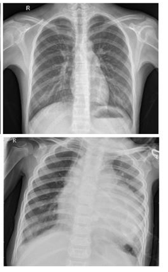
8
Methodology
Image Capture and Encryption
EPHR (Electronic Patient Health Record) Security: Image Sub-sampling and Share Generation
Image Sub-sampling and Share Generation
Watermark Embedding
Blockchain Integration

Slide 10
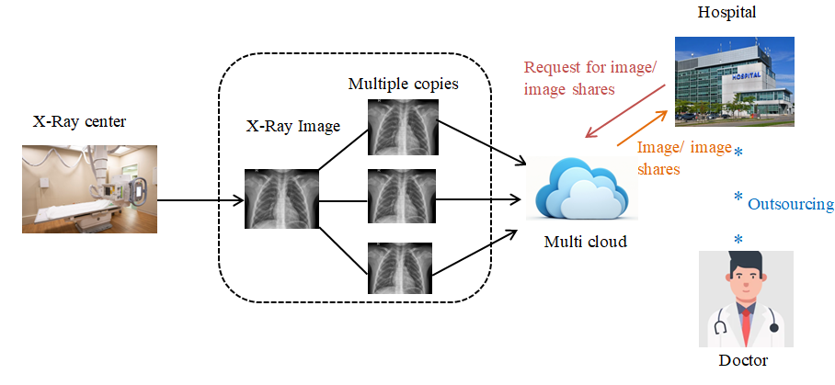
Methodology (Continue)
9
Fig 4: Proposed system

Slide 11
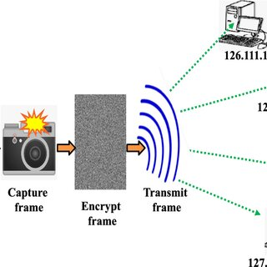
Methodology (Continue)
10
Image Capture and Encryption
Capture X-ray images at the medical center.
Divide the image into multiple encrypted copies for security.
Distribute encrypted copies to various cloud servers for redundancy.

Slide 12
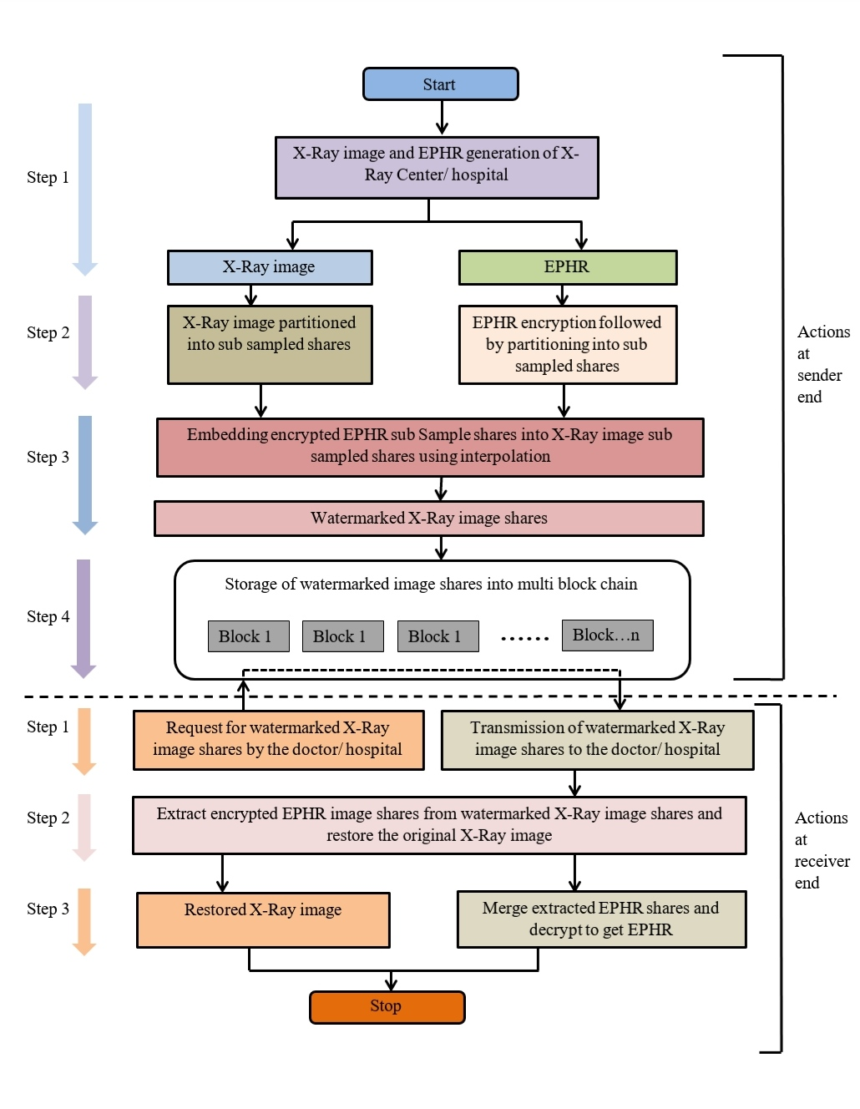
Methodology (Continue)
11
Figure 4.1: Proposed Architecture

Slide 13
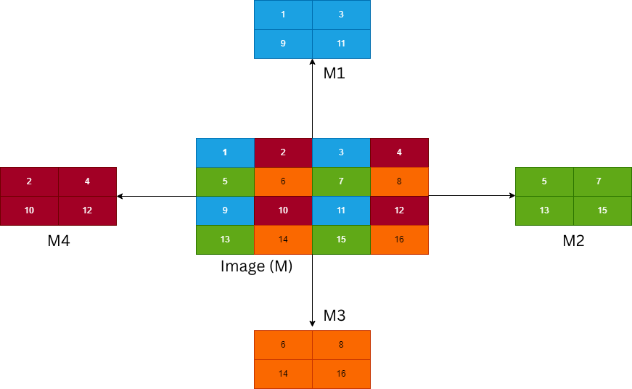
Methodology (Continue)
12
3. Image Sub-sampling and Share Generation:
Divide the encrypted image and EPHR data into multiple shares.
Each share contains a portion of the original data.
This fragmentation enhances security as no single share reveals the complete picture.

Slide 14
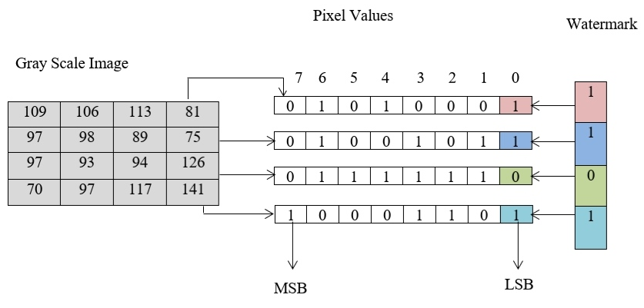
Methodology (Continue)
13
4. Watermark Embedding:
Embed a watermark into the image for tamper detection.
This helps verify the image's authenticity after transmission.
Fig 5.1: Example to data hiding approach (Least significant bit embedding).

Slide 15
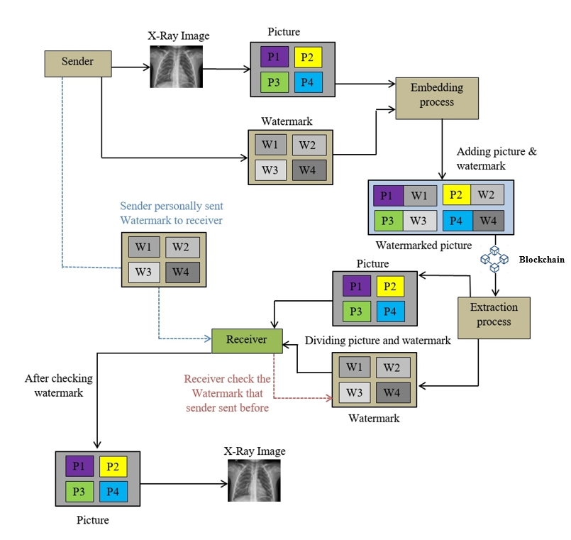
Methodology (continue)
14
5. Blockchain Integration:
Store encrypted image shares and decryption keys on a blockchain.
Blockchain offers a secure and tamper-proof storage solution.
Fig 4.5.3: Block diagram for the proposed embedding and extraction process.

Slide 16
15
Outcomes and Impact
Outcomes:
1. Enhanced Security:
Encrypts images and EPHR data for confidentiality (DSPPS).Fragmentation via sub-sampling hinders unauthorized access to complete data.Optional watermarking detects tampering during transmission.Blockchain integration offers potential for secure, tamper-proof storage.

Slide 17
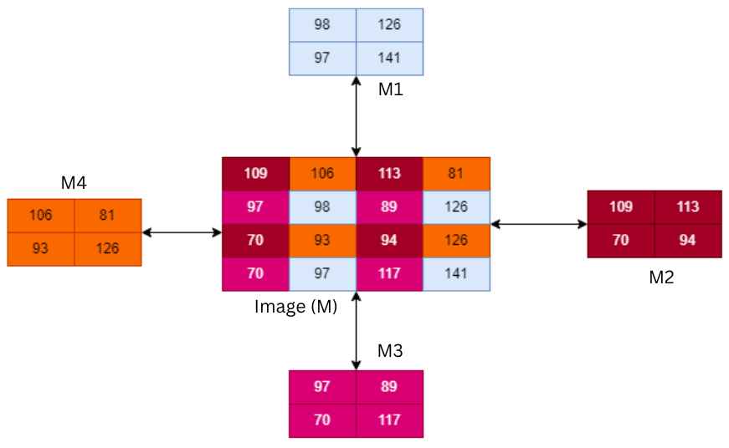
16
Outcomes and Impact (continue)
Figure 5.2.1: Process using a 4x4 image matrix.

Slide 18
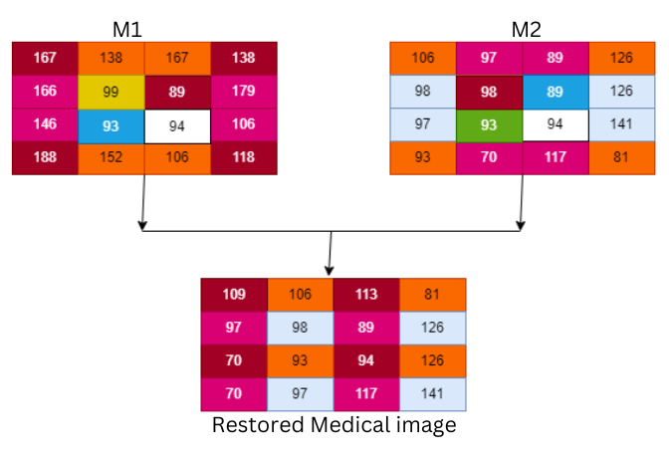
17
Outcomes and Impact (continue)
Figure 5.4.1: Restoring medical image from 𝑀 _{1𝑖𝑚g} , 𝑀 _{2𝑖𝑚𝑔}

Slide 19
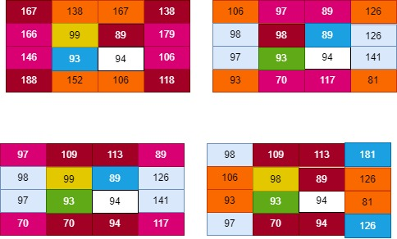
18
Outcomes and Impact (continue)
Figure 5.5.1: Image Pixel Division into 4 Matrices

Slide 20
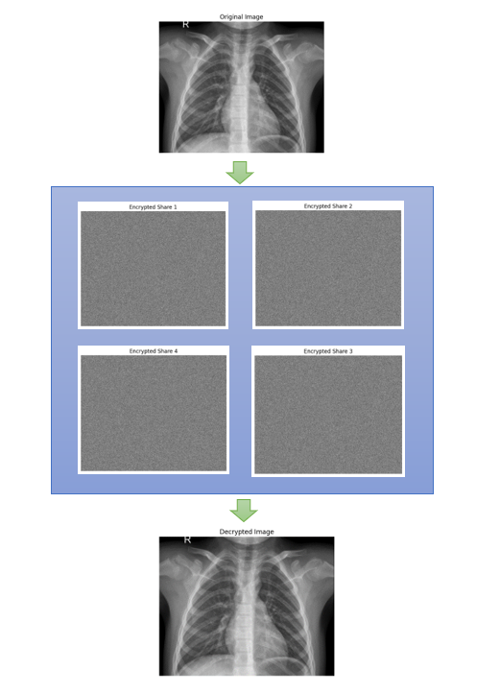
19
Outcomes and Impact (continue)
Figure 5.5.3: Extraction of Original Image from

Slide 21
20
Outcomes and Impact (continue)
2. Improved Privacy: Only authorized personnel can access decrypted images using secure decryption keys.
Encrypted data protects patient privacy by preventing unauthorized access to EPHR information.
3.Data Integrity: Watermarking helps ensure images haven't been tampered with during transmission.Secure storage solutions minimize the risk of data breaches or modifications.

Slide 22
21
Outcomes and Impact (continue)
Impact:
Boosts trust between patients and providers through secure image sharing.
Improves patient care with faster access to images for better diagnoses and treatment.
Enhances collaboration among healthcare professionals across institutions.
Potentially reduces costs by streamlining image sharing processes.

Slide 23
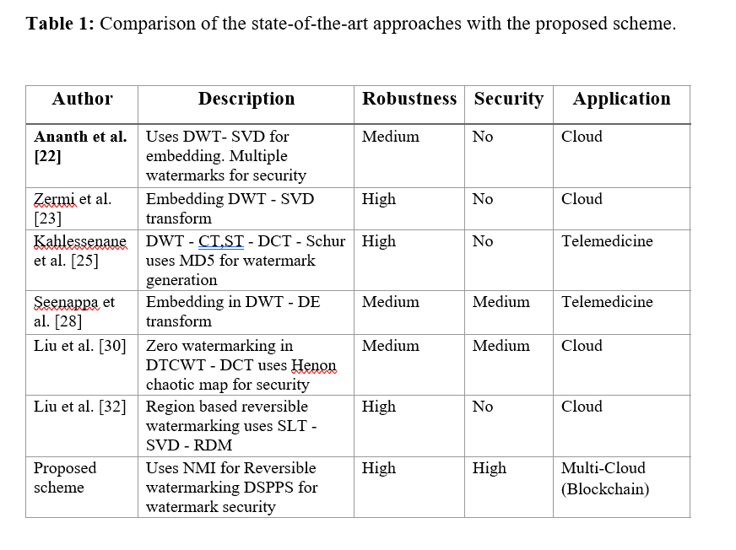
22
Comparative analysis (continue)

Slide 24
23
Conclusion
In conclusion, Blockchain secures medical image sharing in e-healthcare, addressing privacy, security and data integrity. Leverage blockchain's strengths and robust encryption (DSPPS) for secure storage, access control and confidential image transmission. This efficient solution offers granular access control with minimal overhead. Future work focuses on optimization and healthcare system integration.

Slide 25
24
Future Work
Scalability: Explore off-chain storage and sharding for large medical images.
Performance: Optimize smart contracts for access control efficiency.
Security: Evaluate and potentially improve DSPPS encryption for medical images.
Trust Model: Develop methods to verify image authenticity from untrusted parties.
Integration: Ensure interoperability with existing e-healthcare standards.

Slide 26
25
References
O. P. Singh, A. K. Singh, A. Agrawal, and H. Zhou, “SecDH: Security of COVID-19 images based on data hiding with PCA,” Computer Communications, vol. 191, pp. 368–377, Jul. 2022, doi: 10.1016/j.comcom.2022.05.010.
Shini S, Thomas T, Chithraranjan K. Cloud based medical image exchangesecurity challenges. Procedia Eng 2012;38:3454–61.
Singh P, Devi KJ, Thakkar HK, Kotecha K. Region-based hybrid medical image watermarking scheme for robust and secured transmission in IoMT. IEEE Access 2022;10:8974–93.
Mishra P, Vidyarthi A, Siano P. Guest editorial: Security and privacy for cloud-assisted internet of things (IoT) and smart grid. IEEE Trans Ind Inf 2022;18(7):4966–8.
Ramalingam C, Mohan P. Addressing semantics standards for cloud portability and interoperability in multi cloud environment. Symmetry 2021;13(2):317.

Slide 27
References (continue)
26
6. Ghanmi H, Hajlaoui N, Touati H, Hadded M, Muhlethaler P. A secure data storage in multi-cloud architecture using blowfish encryption algorithm. In: Advanced information networking and applications: Proceedings of the 36th international conference on advanced information networking and applications. Vol. 2. Springer; 2022, p. 398–408.
7. Hong J, Dreibholz T, Schenkel JA, Hu JA. An overview of multi-cloud computing. In: Web, artificial intelligence and network applications: Proceedings of the workshops of the 33rd international conference on advanced information networking and applications. Vol. 33. Springer; 2019, p. 1055–68.
8. Apama RM, Shanmugavadivu P. A literature review on medical imaging transfer. In: 2017 International conference on I-SMAC (IoT in social, mobile, analytics and cloud). IEEE; 2017, p. 284–8.
9. Gaurav A, Psannis K, Peraković D. Security of cloud-based medical internet of things (MIoTs): A survey. Int J Softw Sci Comput Int (IJSSCI) 2022;14(1):1–16.
10. Patel P, Ramoliya D, Thumaar M, Nayak A. Advancements in cloud-based solution for medical imaging: A survey. In: 2021 5th International conference on electronics, communication and aerospace technology. IEEE; 2021, p. 811–6. 11. Ibrahim DR, Teh JS, Abdullah R. An overview of visual cryptography techniques. Multimedia Tools Appl 2021;80(21):31927–52.

Slide 28
27
Thank You

